Slide 1

Part III Category learning with a pLoT
Fausto Carcassi
13:30 – 15:00
(1h30m)

Slide 2
Summary so far
pLoT as a picture of cognition
Some formal tools:
Formal grammars
Probabilistic PCFG
Compositional interpretation
(Approximate) Bayesian inference
9:00-10:20 | Introduction: On the very idea of an LoT
10:40-12:30 | Technical background
12:30-13:30 | Lunch
13:30-15:00 | Bayesian program induction (LOTlib3)
15:20-16:30 | Case studies
16:30-17:00 | Summary

Slide 3
Plan for session
We’ll consider two examples
Combine the technical tools
Build up to a pLoT category learning simulation
9:00-10:20 | Introduction: On the very idea of an LoT
10:40-12:30 | Technical background
12:30-13:30 | Lunch
13:30-15:00 | Bayesian program induction (LOTlib3)
15:20-16:30 | Case studies
16:30-17:00 | Summary

Slide 4
Example 1: The visual domain

Slide 5
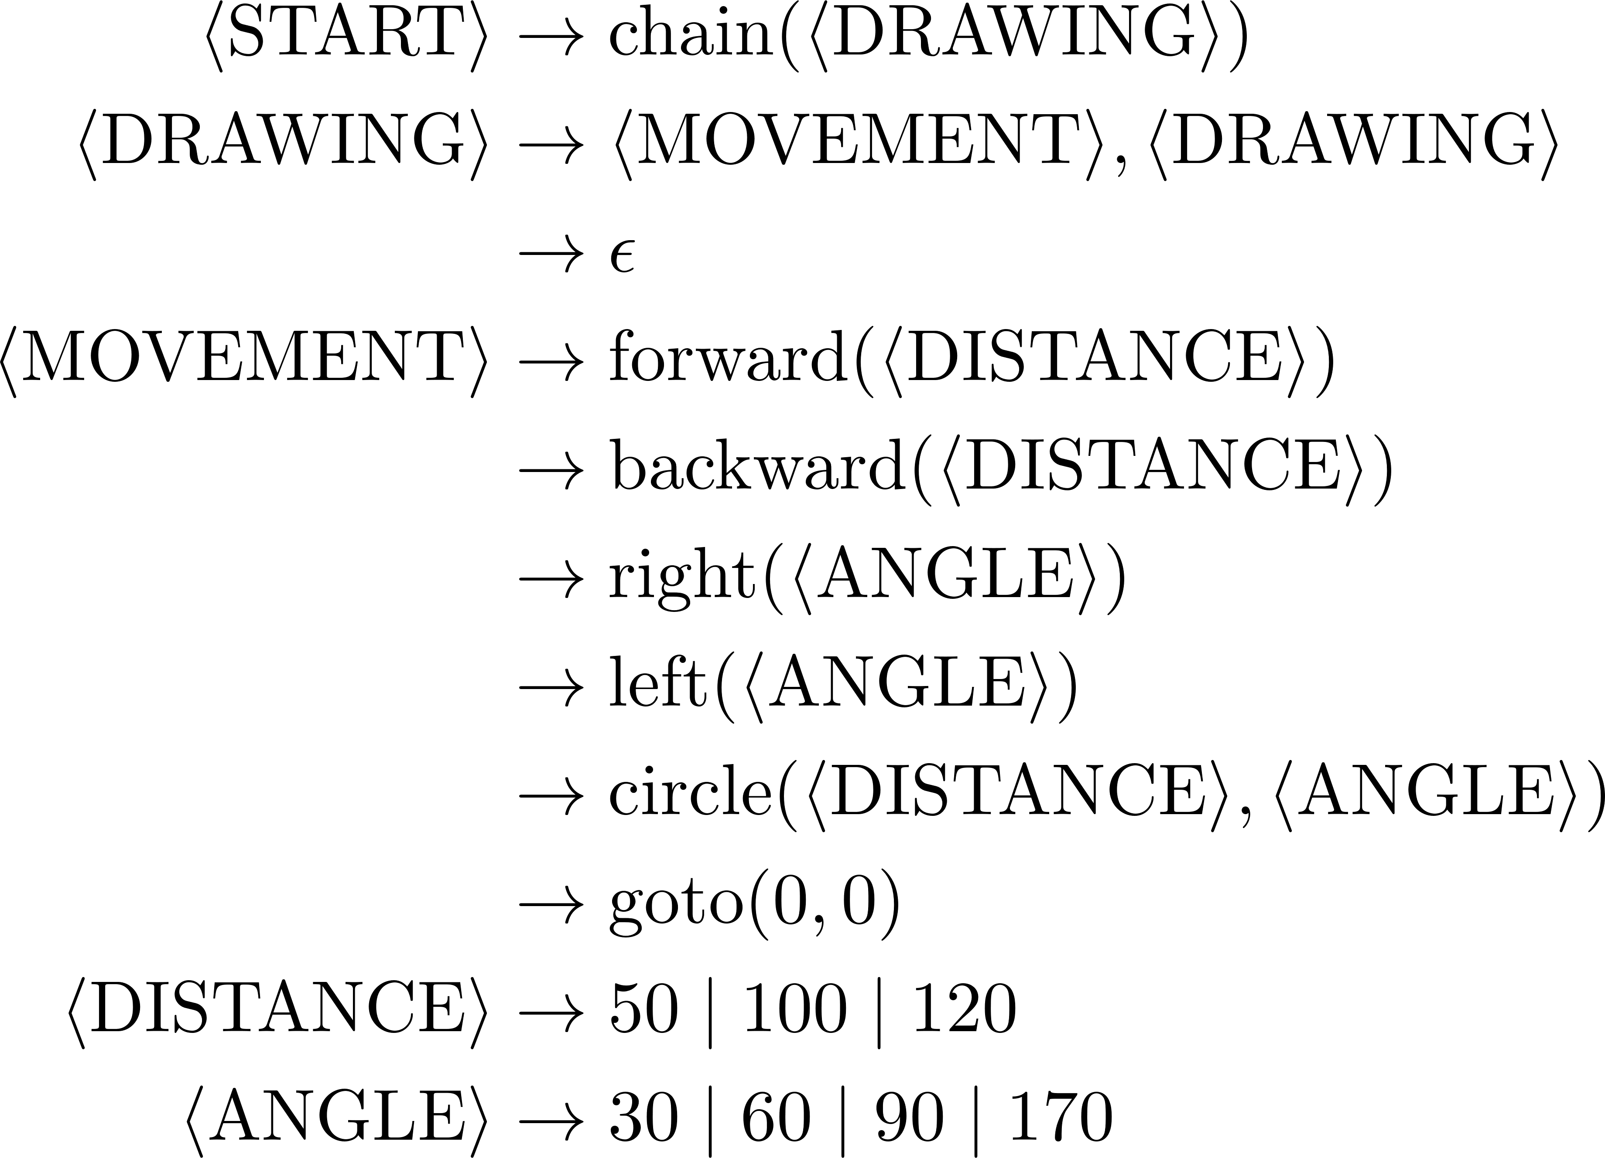
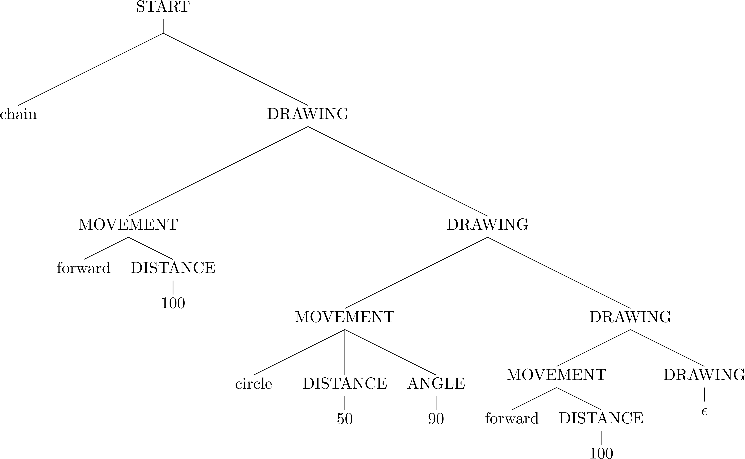
Example 1: Shape grammar

Slide 6
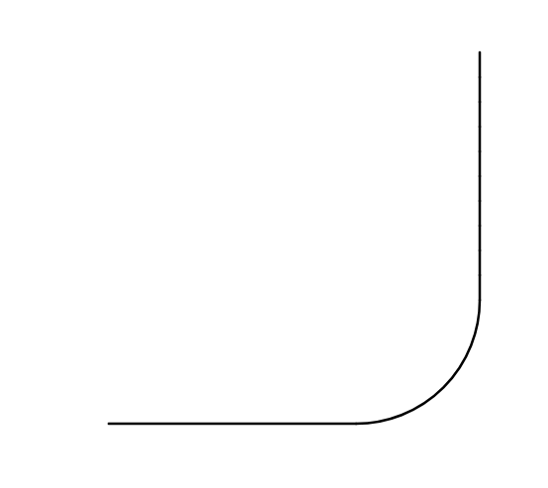
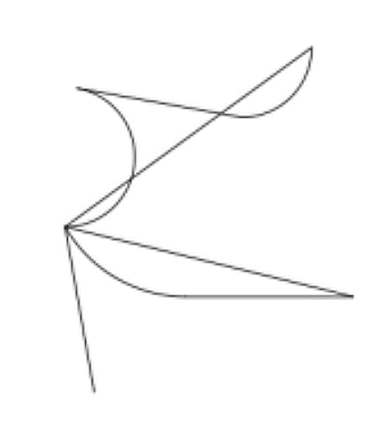
Example 1: Shape semantics

Slide 7
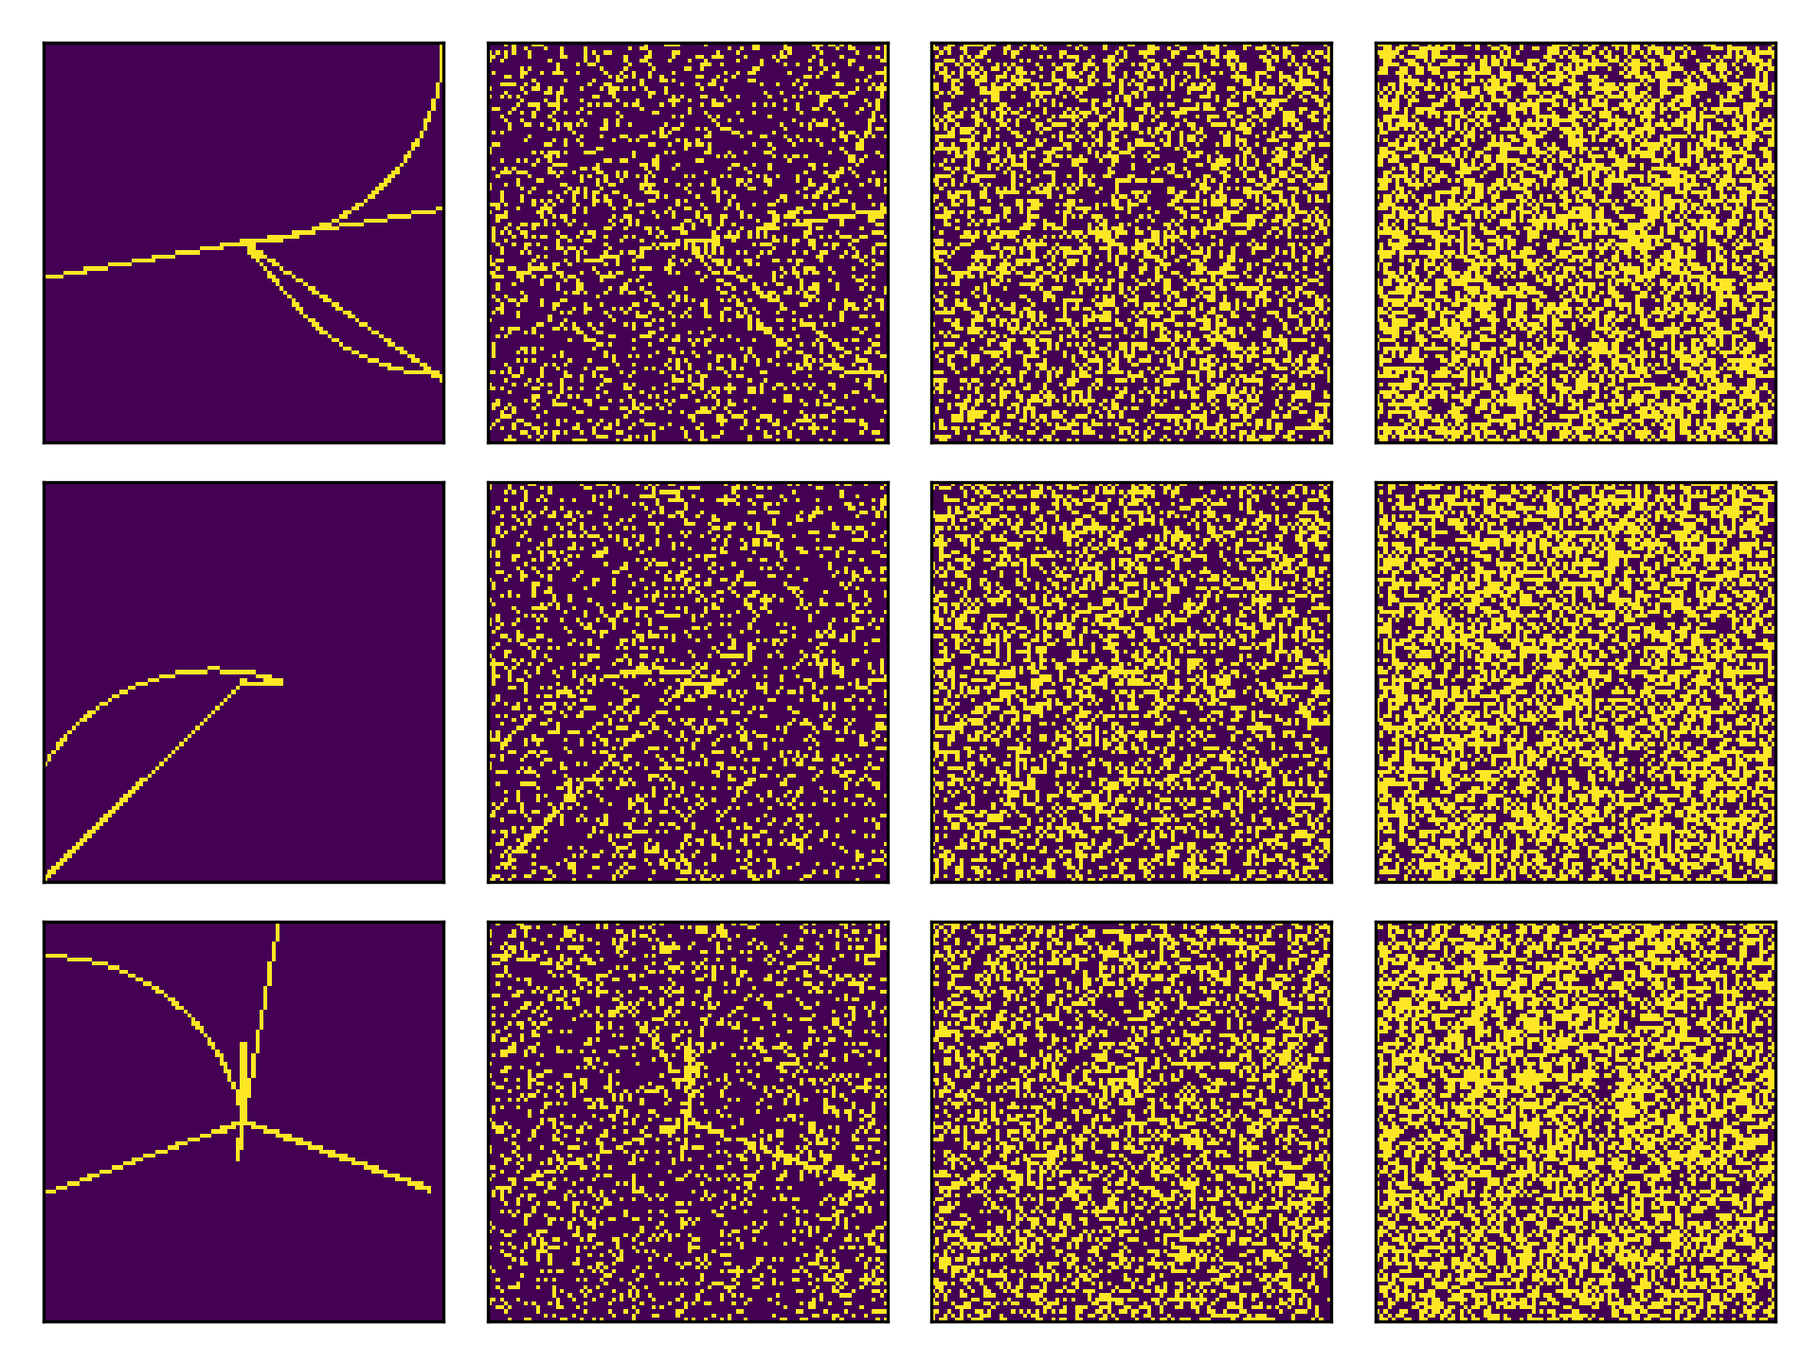
Example 1: Shape observations

Slide 8
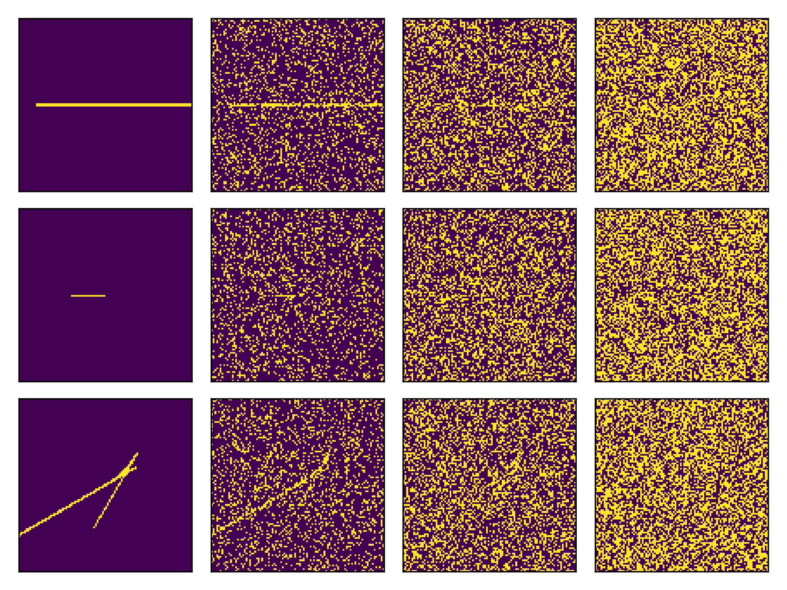


Example 1: Priors and likelihoods
Observations
Noise level 1
Noise level 2
Noise level 3

Slide 9
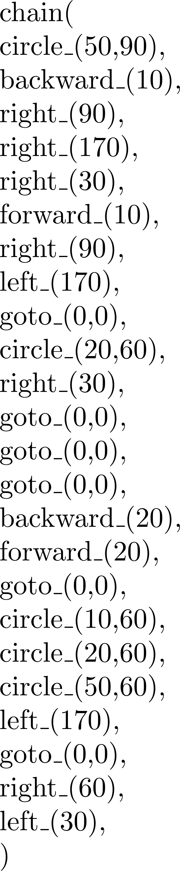
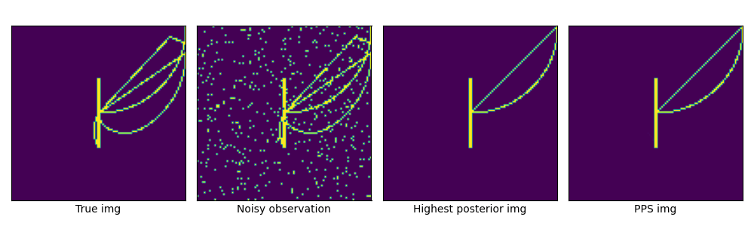
Bayesian inference in the shape grammar
True shape
Noisy observation
Higher posterior shape
Posterior mean

Slide 10
LoT learning models: the big picture
Interpreted PCFG
Defines hypotheses H
Defines a prior over H
Observations O
Generated by true H
Likelihood P(O | H)
Bayesian inference algorithm
Approximate!
Shapes grammar
Each H is a sentence…
…which encodes a shape
Image (with noise)
Multiple H produce same shape!
Likelihood P(image| shape)
MCMC w/ e.g., LOTlib3
Gives us samples from posterior!

Slide 11
Example 2: The auditory domain

Slide 12
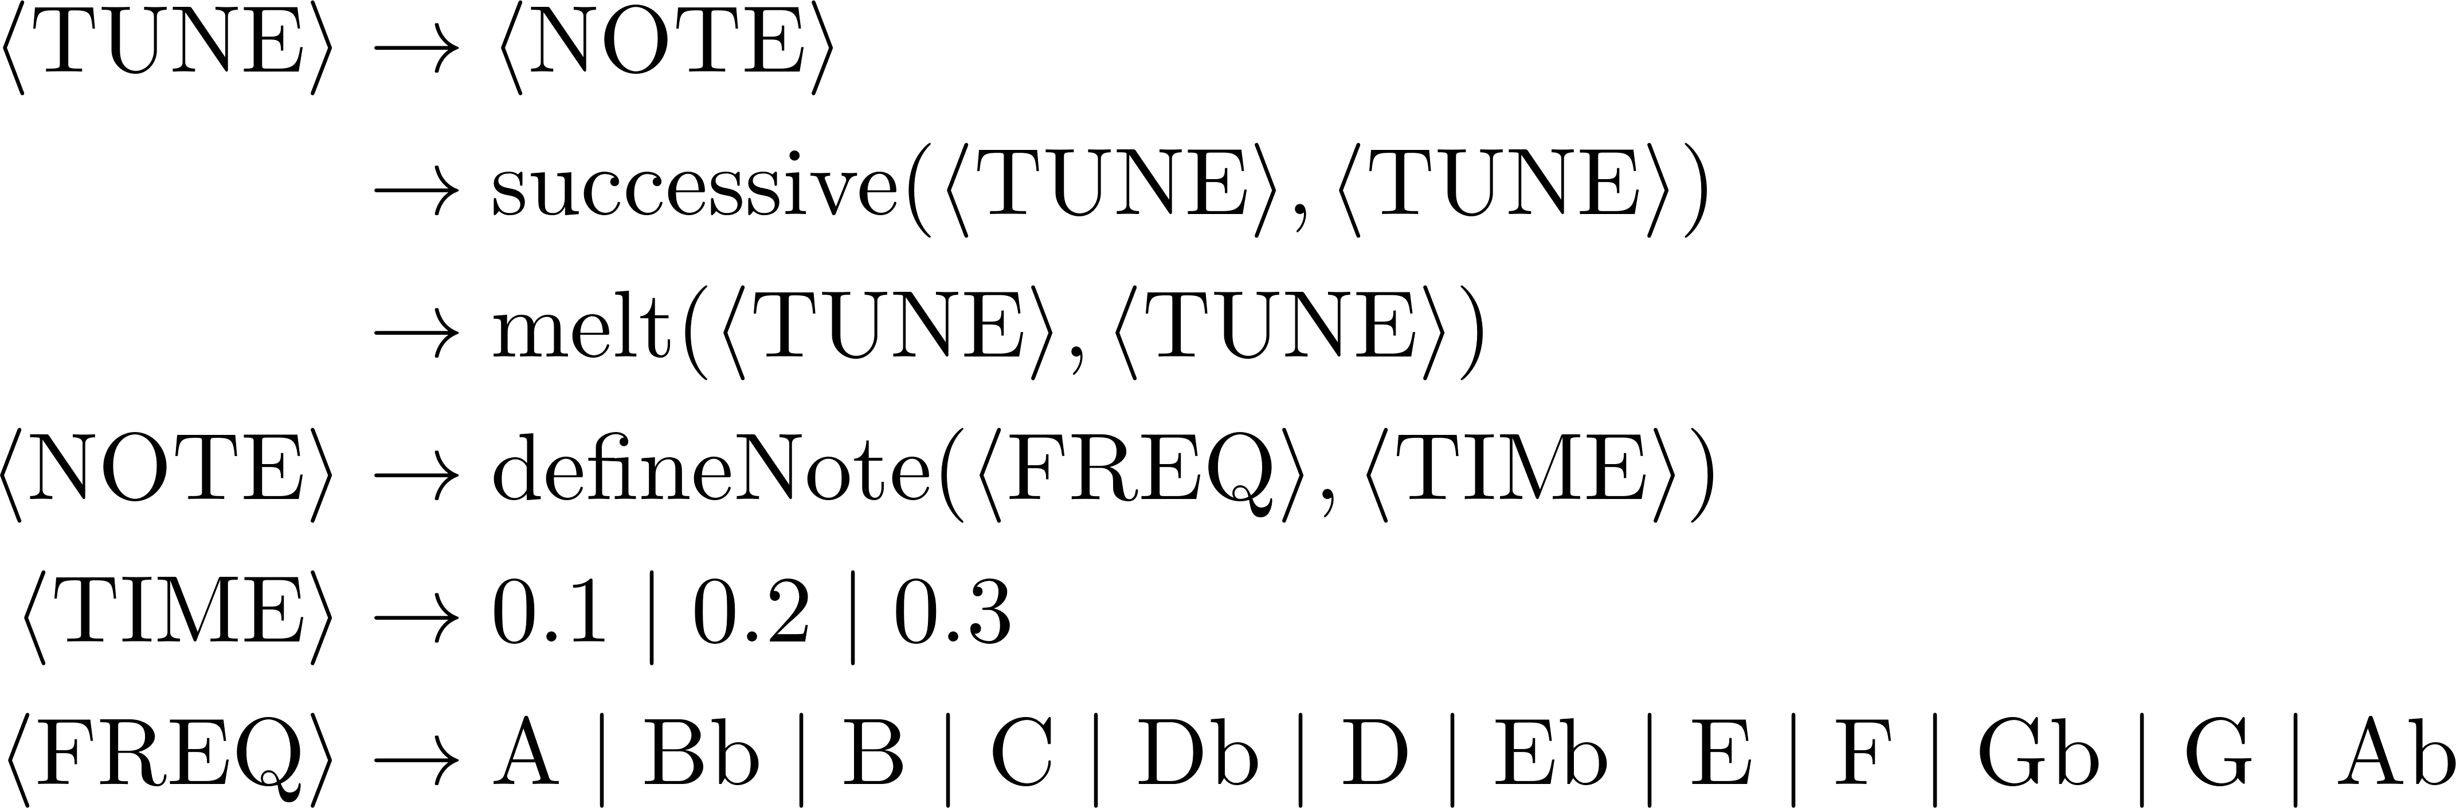
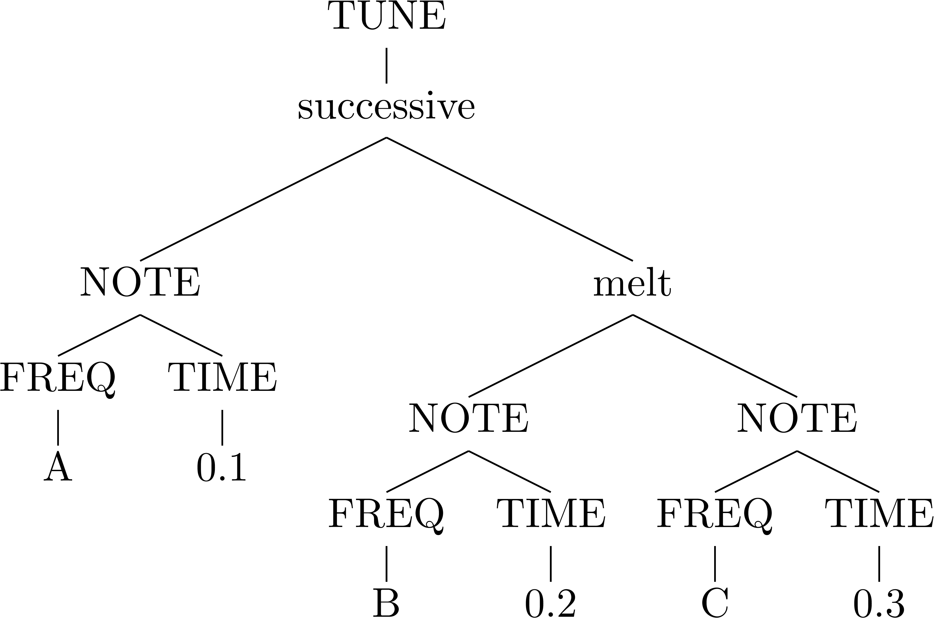
Example 2: Sound grammar
(For the sake of our ears, let’s only keep A, C, D, E, G)

Slide 13
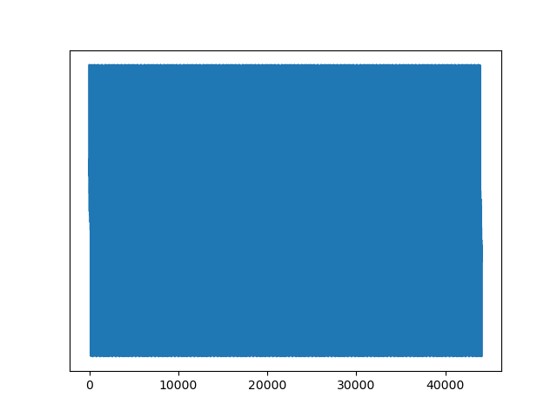
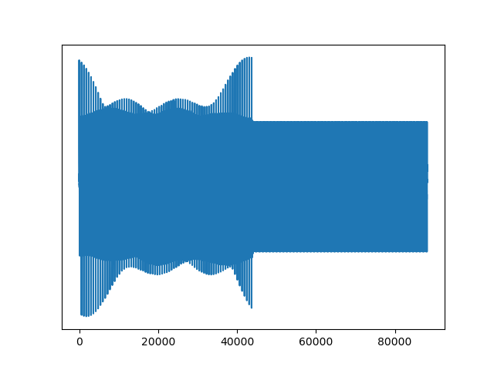


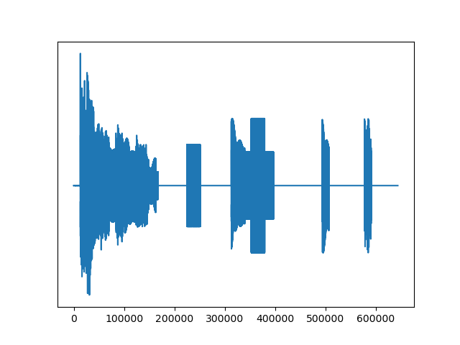
Example 1: Sound semantics

Slide 14
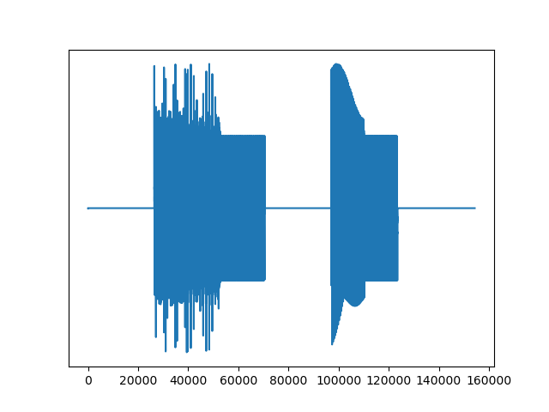
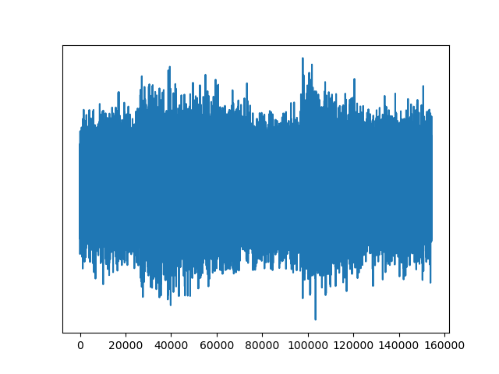
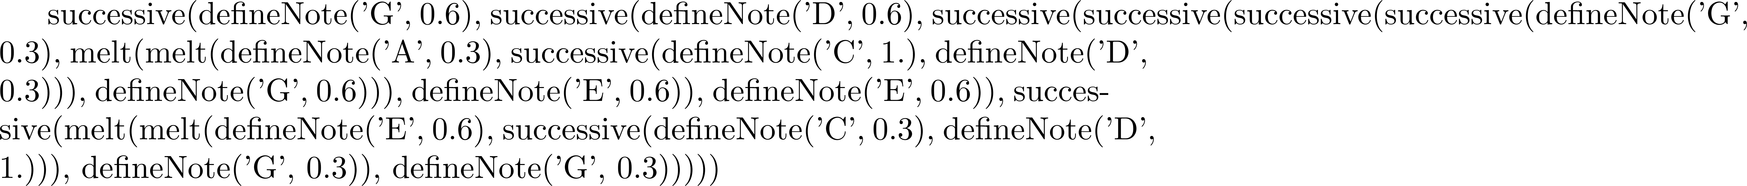
Example 1: Audio observations

Slide 15
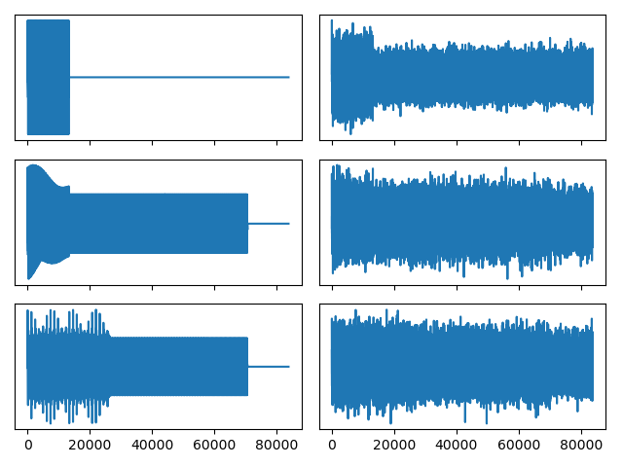


Example 1: Priors and likelihoods

Slide 16
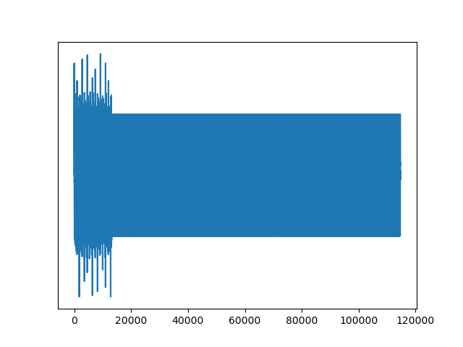
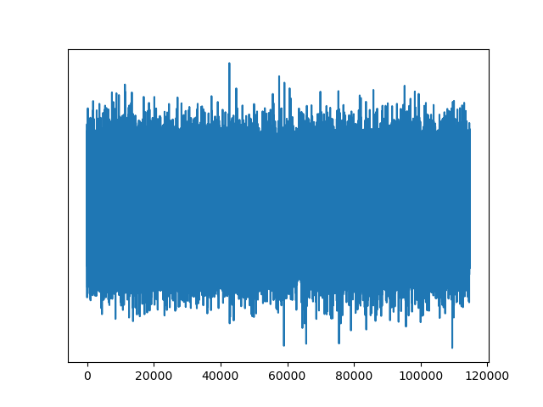
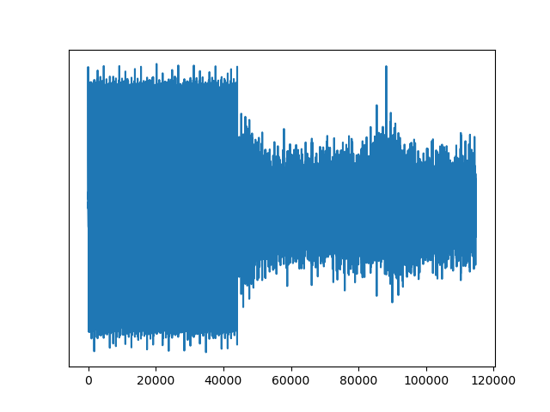
Learning: Bayesian inference in a PCFG
MAP
Posterior mean

Slide 17
LoT learning models: the big picture
Interpreted PCFG
Defines hypotheses H
Defines a prior over H
Observations O
Generated by true H
Likelihood P(O | H)
Bayesian inference
Approximate!
Sound grammar
Each H is a sentence…
…which encodes a sound
Sound (with noise)
Multiple H produce same sound!
Likelihood P(audio | sound)
MCMC w/ e.g., LOTlib3
Gives us samples from posterior!

Slide 18
Summary: Building a pLoT model
Pick a domain, e.g., music, geometry, logical concepts
Write a (plausible) list of primitive concepts
Write a PCFG
Define a likelihood function
Produce an observation
Sample from the PCFG
Hand-design
Use naturally occurring
Run inference algorithm

Slide 19
Important features
Simpler representations have a higher prior
Simpler <--> More probable in the pLoT (PCFG)
In domains above, pLoT sentences denoted single objects
…but each sentence in the pLoT can denote a function
Observations are (inputs, output) tuples
Categories (sets) are a special case with Boolean output
Observations are e.g., samples from the category
Size effect!

Slide 20

Some hypotheses types
Input | Output | Stochastic | Meaning | Example
 | Domain object | No | Single domain object | Shape
 |  | Yes | Graded category | Cup
Domain object | Boolean | No | Category | Primes
 |  | Yes | Graded category
Domain object | Domain object | No | Transformation | Adding 3
 |  | Yes | Stochastic transf | Jumping
… | … | … | …

Slide 21
Conclusions
We saw how to construct a model of category learning w/ a pLoT
Two example domains:
Shapes
Sounds
Many more to be explored!
Next step: Literature using this kind of model.
9:00-10:20 | Introduction: On the very idea of an LoT
10:40-12:30 | Technical background
12:30-13:30 | Lunch
13:30-15:00 | Bayesian program induction (LOTlib3)
15:20-16:30 | Case studies
16:30-17:00 | Summary

Slide 22
If there’s time left…
Construct a grammar
Grammar for categorization based on binary features
Grammar for encoding binary strings
Improve the two discussed grammars
Modify the shape and sound grammars to be more cognitively plausible.

